Slide 1
Proximity based one-class classification with Common N-Gram dissimilarity for authorship verification task
Magdalena Jankowska, Vlado Kešelj and Evangelos Milios
Faculty of Computer Science, Dalhousie University
September 2014

Slide 2
Example
"The Cuckoo's Calling“
2013 detective novel by Robert Galbraith

Slide 3
Example
"The Cuckoo's Calling“
2013 detective novel by Robert Galbraith
Question by Sundays Times
Was “The Cuckoo’s Calling” really written by J.K. Rowling?
Peter Millican and Patrick Juola requested (independently)
to answer this question through their algorithmic methods
Results indicative of the positive answer
J. K. Rowling admitted that she is the author

Slide 4
Authorship verification problem
Set of “known” documents
by a given author
Input:
$$A$$
document of
a questioned authorship
$$u$$
“unknown” document

Slide 5
Authorship verification problem
Set of “known” documents
by a given author
Input:
$$A$$
document of
a questioned authorship
$$u$$
“unknown” document
Question:
Was u written
by the same author?

Slide 6
Motivation
Applications:
Forensics
Security
Literary research

Slide 7
Our approach to
the authorship verification problem
Proximity-based one-class classification. Is u “similar enough” to A?
Idea similar to the k-centres method for one-class classification
Applying CNG dissimilarity between documents
$$A$$
document of
a questioned authorship
$$u$$
“unknown” document

Slide 8
Common N-Gram (CNG) dissimilarity
Proposed by
Vlado Kešelj, Fuchun Peng, Nick Cercone, and Calvin Thomas.
N-gram-based author profiles for authorship attribution.
In Proc. of the Conference Pacific Association for Computational Linguistics, 2003.
Proposed as a dissimilarity measure
of the Common N-Gram (CNG) classifier for multi-class classification
?
the least
dissimilar class
works of Carroll
works of Twain
works of Shakespeare
Successfully applied to the authorship attribution problem

Slide 9
Character N-Grams
Character n-grams
Strings of n consecutive characters
from a given text
Alice was beginning to get very tired of sitting by her sister on the bank, and of having nothing to do:
Alice's Adventures in the Wonderland
by Lewis Carroll
n=4
4-grams
Alic

Slide 10
Character N-Grams
Character n-grams
Strings of n consecutive characters
from a given text
Alice was beginning to get very tired of sitting by her sister on the bank, and of having nothing to do:
Alice's Adventures in the Wonderland
by Lewis Carroll
n=4
4-grams
Alic
lice

Slide 11
Character N-Grams
Character n-grams
Strings of n consecutive characters
from a given text
Alice was beginning to get very tired of sitting by her sister on the bank, and of having nothing to do:
Alice's Adventures in the Wonderland
by Lewis Carroll
n=4
4-grams
Alic
lice
ice_

Slide 12
Character N-Grams
Character n-grams
Strings of n consecutive characters
from a given text
Alice was beginning to get very tired of sitting by her sister on the bank, and of having nothing to do:
Alice's Adventures in the Wonderland
by Lewis Carroll
n=4
4-grams
Alic
lice
ice_
ce_w

Slide 13
CNG dissimilarity - formula
Profile
a sequence of L most common n-grams of a given length n

Slide 14
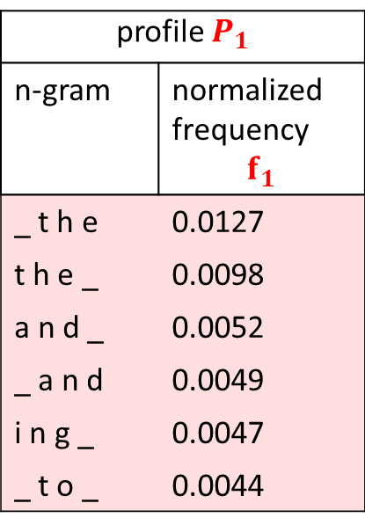
CNG dissimilarity - formula
Profile
a sequence of L most common n-grams of a given length n
Example for n=4, L=6
document 1:
Alice's Adventures in the Wonderland
by Lewis Carroll
profile $P_{1}$
n-gram | normalized frequency $$f_{1}$$
_ t h e | 0.0127
t h e _ | 0.0098
a n d _ | 0.0052
_ a n d | 0.0049
i n g _ | 0.0047
_ t o _ | 0.0044

Slide 15
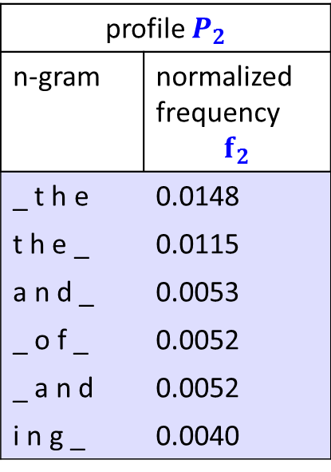
CNG dissimilarity - formula
Profile
a sequence of L most common n-grams of a given length n
Example for n=4, L=6
document 1:
Alice's Adventures in the Wonderland
by Lewis Carroll
document 2:
Tarzan of the Apes
by Edgar Rice Burroughs
profile $P_{1}$
n-gram | normalized frequency $$f_{1}$$
_ t h e | 0.0127
t h e _ | 0.0098
a n d _ | 0.0052
_ a n d | 0.0049
i n g _ | 0.0047
_ t o _ | 0.0044
profile $P_{2}$
n-gram | normalized frequency $$f_{2}$$
_ t h e | 0.0148
t h e _ | 0.0115
a n d _ | 0.0053
_ o f _ | 0.0052
_ a n d | 0.0052
i n g _ | 0.0040

Slide 16
CNG dissimilarity - formula
Profile
a sequence of L most common n-grams of a given length n
Example for n=4, L=6
document 1:
Alice's Adventures in the Wonderland
by Lewis Carroll
document 2:
Tarzan of the Apes
by Edgar Rice Burroughs
profile $P_{1}$
n-gram | normalized frequency $$f_{1}$$
_ t h e | 0.0127
t h e _ | 0.0098
a n d _ | 0.0052
_ a n d | 0.0049
i n g _ | 0.0047
_ t o _ | 0.0044
CNG dissimilarity between
these documents
$$D=\sum_{{x∈P}_{1}∪P_{2}}{{\left(\frac{f_{1}\left(x\right)−f_{2}\left(x\right)}{\left(\frac{f_{1}\left(x\right)+f_{2}\left(x\right)}{2}\right)}\right)}^{2}}$$
where
$f_{i}\left(x\right)=0$
if $x$does not appear in $P_{i}$
profile $P_{2}$
n-gram | normalized frequency $$f_{2}$$
_ t h e | 0.0148
t h e _ | 0.0115
a n d _ | 0.0053
_ o f _ | 0.0052
_ a n d | 0.0052
i n g _ | 0.0040

Slide 17
Proximity-based one-class classification:
dissimilarity between instances
Set of “known” documents
by a given author
Dissimilarity between
a given “known” document
and the “unknown” document
$$A$$
$$d_{i}$$
$$D\left(d_{i}, u\right)$$
$$u$$
“unknown” document

Slide 18
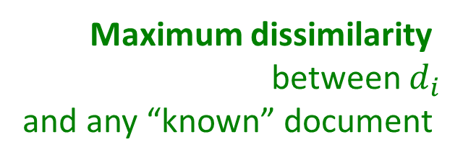
Proximity-based one-class classification:
dissimilarity between instances
Set of “known” documents
by a given author
Dissimilarity between
a given “known” document
and the “unknown” document
$$A$$
$$d_{i}$$
$$D\left(d_{i}, u\right)$$
Maximum dissimilarity
between $d_{i}$
and any “known” document
$$u$$
“unknown” document
$$D^{max}\left(d_{i}, A\right)$$
this author’s document
most dissimilar to $d_{i}$

Slide 19
Proximity-based one-class classification:
dissimilarity between instances
Dissimilarity ratio of $d_{i}$ :
How much more/less dissimilar is the “unknown” document than the most dissimilar document by the same author.
$$r\left(d_{i}, u, A\right)=\frac{D\left(d_{i}, u\right)}{D^{max}\left(d_{i}, A\right)}$$
$$A$$
$$d_{i}$$
$$D\left(d_{i}, u\right)$$
$$u$$
$$D^{max}\left(d_{i}, A\right)$$
this author’s document
most dissimilar to $d_{i}$

Slide 20
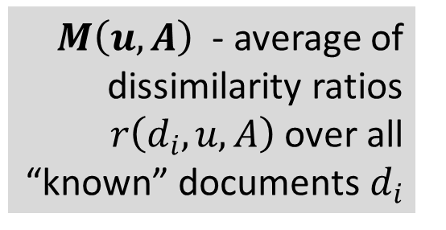
Proximity-based one-class classification:
proximity between a sample and the positive class instances
Measure of proximity between the “unknown” document
and the set A of documents by a given author:
$M\left(u,A\right)$ - average of
dissimilarity ratios
$r\left(d_{i}, u, A\right)$ over all “known” documents $d_{i}$
$$A$$
$$M\left(u,A\right)$$
$$u$$
“unknown” document

Slide 21
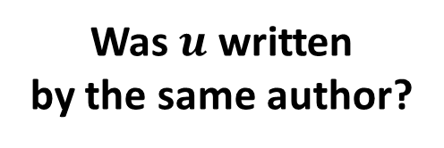
Proximity-based one-class classification:
thresholding on the proximity
Iff $M\left(u,A\right)$less than or equal to a threshold $θ$ :
classify u as belonging to A
$$A$$
$$M\left(u,A\right)$$
$$u$$
“unknown” document
Was $u$ written
by the same author?
Yes, iff $M\left(u,A\right)< θ$

Slide 22
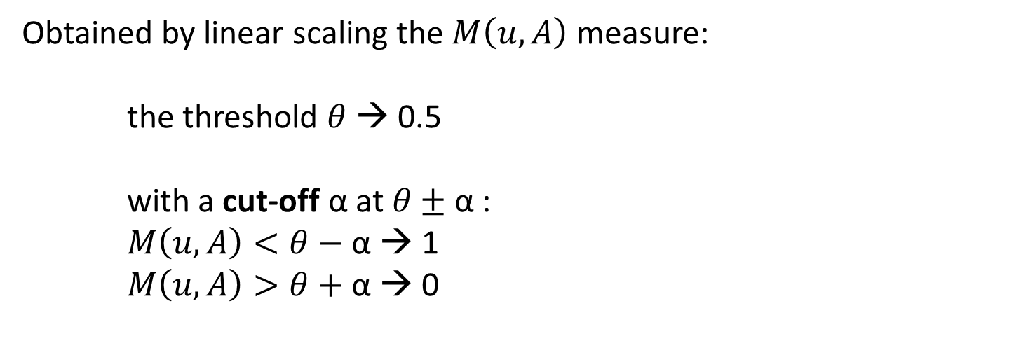
Confidence scores
Obtained by linear scaling the $M\left(u,A\right)$ measure:
the threshold $θ$ → 0.5
with a cut-off α at $θ±$ α :
$M\left(u,A\right)<θ−$α → 1
$M\left(u,A\right)>θ+\text{α}$ → 0

Slide 23
Parameters
Parameters of our method:
n – n-gram length
L – profile length: number of the most common n-grams considered
θ – threshold for the proximity measure M for classification

Slide 24
Proximity-based one-class classification:
special conditions used
Dealing with instances when only 1 “known” document by a given author is provided:
dividing the single “known” document into two halves and
treating them as two “known” documents
Dealing with instances when some documents do not have enough character n-grams to create a profile of a chosen length:
representing all documents in the instance by equal profiles
of the maximum length for which it is possible
Additional preprocessing (tends to increase accuracy on training data):
cutting all documents in a given instance to an equal length in words

Slide 25
Ensembles
Ensembles combine classifiers that differ between each other with respect to at least one of the three document representation parameters:
type of the tokens for n-grams (word or character)
size of n-grams
length of a profile
Aggregating results by majority voting or voting weighted by confidence score by a classifier

Slide 26
Testbed1: PAN 2013 competition dataset
PAN 2013 – 9th evaluation lab on
uncovering plagiarism, authorship, and social software misuse
Author Identification task:
Author Verification problem instances in English, Greek and Spanish

Slide 27
Competition submission: a single classifier
Parameters for the competition submission selected using experiments on training data in Greek and English:
provided by the competition organizers
compiled by ourselves from existing datasets for other authorship attribution problems
For Spanish: the same parameters as for English
 | English Spanish | Greek
n (n-gram length) | 6 | 7
L (profile length) | 2000 | 2000
θ (threshold) if at least two “known” documents given | 1.02 | 1.008
θ (threshold) if only one “known” document given | 1.06 | 1.04

Slide 28
Results of PAN 2013 competition submission
 | Entire set | English subset | Greek subset | Spanish subset
Evaluation measure: F₁ (identical to accuracy for our method) (18 teams)
F₁ of our method | 0.659 | 0.733 | 0.600 | 0.640
competition rank | 5th (shared) of 18 | 5th (shared) of 18 | 7th (shared) of 16 | 9th of 16
best F₁ of other competitors | 0.753 | 0.800 | 0.833 | 0.840
Secondary competition evaluation measure: AUC (10 teams)
AUC | 0.777 | 0.842 | 0.711 | 0.804
competition rank | 1st of 10 | 1st of 10 | 2nd of 10 | 2nd of 10
Best AUC of 9 other participants | 0.735 | 0.837 | 0.824 | 0.926

Slide 29
Evaluation of ensembles on PAN 2013 dataset (after contest)
Selected experimental results for ensembles | Entire set |  | English subset |  | Spanish subset |  | Greek subset
 | Acc. | AUC | Acc. | AUC | Acc. | AUC | Acc. | AUC
Our ensembles: weighted voting, all classifiers in the considered parameter space
character based | 0.729 | 0.764 | 0.833 | 0.830 | 0.800 | 0.859 | 0.567 | 0.582
character and word based | 0.741 | 0.780 | 0.800 | 0.842 | 0.840 | 0.853 | 0.600 | 0.622
Our ensemble: weighted voting, classifiers selected based on performance on train data
character and word based | 0.788 | 0.805 | 0.800 | 0.857 | 0.840 | 0.853 | 0.733 | 0.687
Methods by other PAN’13 participants (different methods in different columns)
best results over other participants | 0.753 | 0.735 | 0.800 | 0.837 | 0.840 | 0.926 | 0.833 | 0.824

Slide 30
Evaluation on PAN 2014 author verification competition
Difference in dataset as compared to PAN 2013:
fewer known documents per problem (max 5), in particular two datasets where only one known document is given per problem
more problems in testing and training set
more data categories:
languages: English, Dutch, Spanish, Greek
different genre categories

Slide 31
Our submission to PAN 2014 competition
Separate ensemble for each category (language&genre combination)
Ensembles selected based on performance on training data: fixed odd number of 31 classifiers with the best AUC
Threshold set to the average of optimal thresholds of the selected classifiers on the train data (thresholds on which maximum accuracy achieved)

Slide 32
Results on PAN 2014 dataset: articles in Greek and Spanish
Greek articles
our competition rank: 5th of 13
 | Product of AUC and c@1 | AUC | c@1
our submission | 0.497 | 0.731 | 0.680
result of the top participant | 0.720 | 0.889 | 0.810
Spanish articles
our competition rank: 3rd of 13
 | Product of AUC and c@1 | AUC | c@1
our submission | 0.586 | 0.803 | 0.730
result of the top participant | 0.698 | 0.898 | 0.778

Slide 33
Results on PAN 2014 dataset: Dutch essays and reviews
Dutch essays
our competition rank: 6th of 13
 | Product of AUC and c@1 | AUC | c@1
our submission | 0.732 | 0.869 | 0.842
result of the top participant | 0.823 | 0.932 | 0.883
Dutch reviews
our competition rank: 5th of 13
 | Product of AUC and c@1 | AUC | c@1
our submission | 0.357 | 0.638 | 0.560
result of the top participant | 0.525 | 0.757 | 0.694

Slide 34
Results on PAN 2014 dataset: English essays and novels
English essays
our competition rank: 12th of 13
 | Product of AUC and c@1 | AUC | c@1
our submission | 0.284 | 0.518 | 0.548
result of the top participant | 0.513 | 0.723 | 0.710
English novels
our competition rank: 13th of 13
 | Product of AUC and c@1 | AUC | c@1
our submission | 0.225 | 0.491 | 0.457
result of the top participant | 0.508 | 0.711 | 0.715

Slide 35
Results on PAN 2014 dataset: entire data set
PAN 2014 entire data set
our competition rank: 9th of 13
 | Product of AUC and c@1 | AUC | c@1
our submission | 0.367 | 0.609 | 0.602
result of the top participant | 0.490 | 0.718 | 0.683

Slide 36
Discussion of results on PAN 2013 and PAN 2014 datasets
The ensembles of word-based and character based classifiers with weighted voting and that used the training data were tested on both PAN 2013 and PAN 2014 sets
Our method is best suited for problems with at least 3 “known” documents (as it takes advantage of the pair of the most dissimilar known documents). On all evaluation sets in which the average number of known documents is at least 3 per problem, the results were satisfactory (corresponding to the 3rd or higher competition rank):
PAN 2013 entire set
PAN 2013 English set
PAN 2013 Spanish set
PAN 2013 Greek set
PAN 2014 Spanish articles set
Problems with only one known documents are very challenging for our method. On the two datasets for which the number of known documents was 1 per problem, the results were very poor:
PAN 2014 English novels
PAN 2014 Dutch reviews
More investigation is needed for explaining the extremely poor performance on PAN 2014 English essays. One special feature of this set is that is the only one where the authors are not native speakers

Slide 37
Conclusion
An intrinsic one-class proximity based classification for authorship verification
Evaluated on datasets of PAN 2013 and PAN 2014 author verification competition: competitive results for sets with the average number of documents of known authorship is at least 3
Poor results on problems with only 1 document of known authorship
Ensembles of character based and word based classifiers seems to work best

Slide 38
Future work
Better adaptation of the method for the problems where only one known document is present
Investigating dividing known documents into more chunks instead of just two. This may also be applied and possibly improve the performance for cases when 2 known documents are present
analysis of the role of word n-grams and character n-grams depending on the genre of the texts, and on the topical similarity between the documents

Slide 39
Thank you!

